Slide 1
Real time satellite observation of severe events:
Identifying overshooting tops of convective clouds in MSG

Slide 2
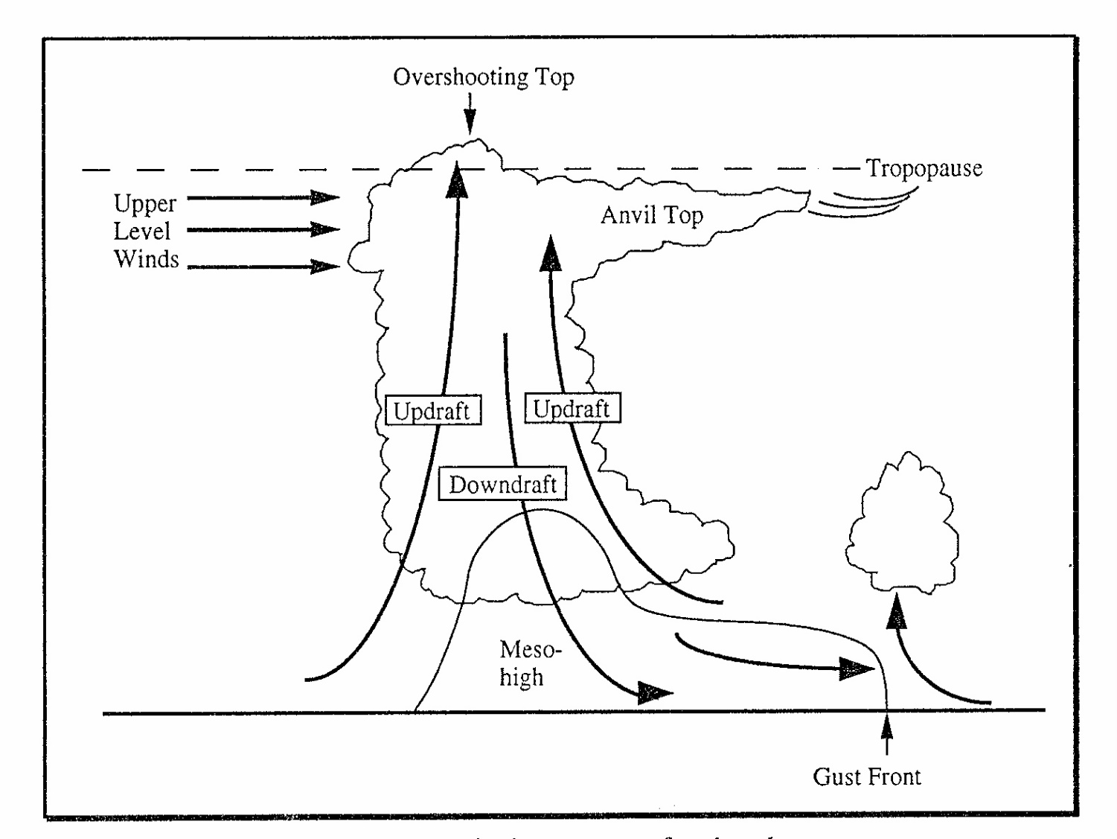
Schematic of overshooting tops

Slide 3
Overshooting Top (OT), Mali
26 June 2014
17:30 UTC
Example supplied by
Jochen Kerkmann, EUMETSAT

Slide 4
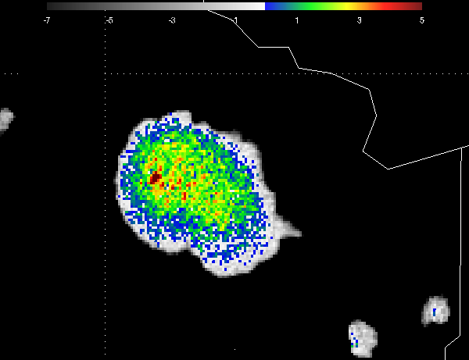
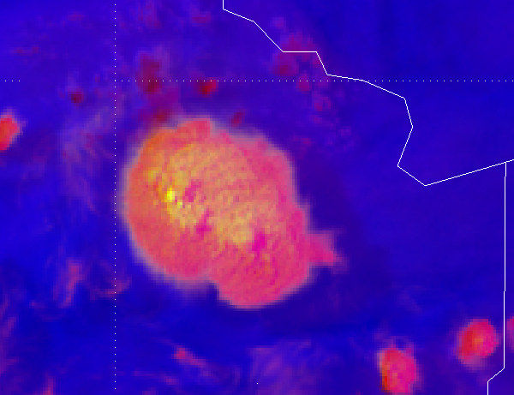
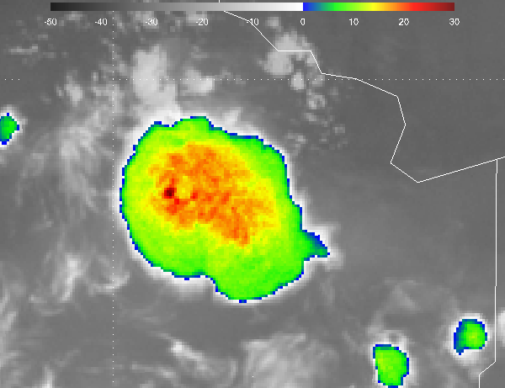
WV6.2-IR108 – good for over shooting tops and cloud depth (also in CRR)
IR097-IR108 – optical depth/phase
WV6.2-IR10.8
RGB Convection IR9.7-IR10.8

Slide 5
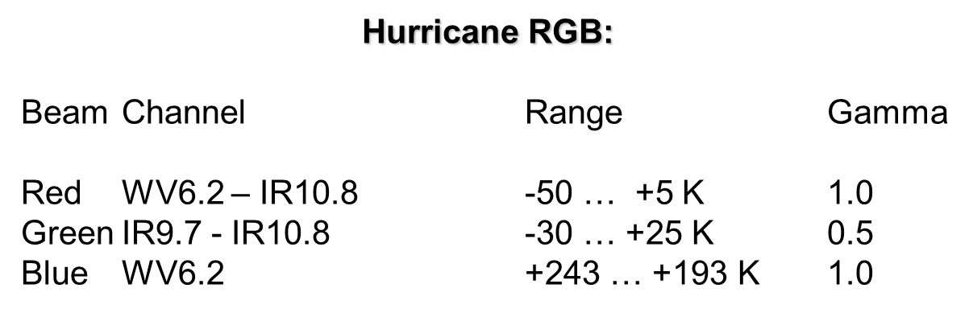
OT RGB recipe
Slide by Jochen Kerkmann

Slide 6
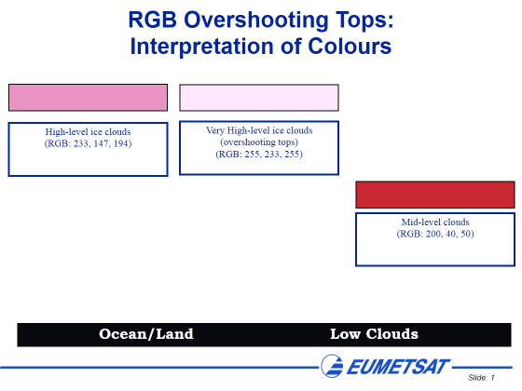
Slide by Jochen Kerkmann

Slide 7
Examples

Slide 8
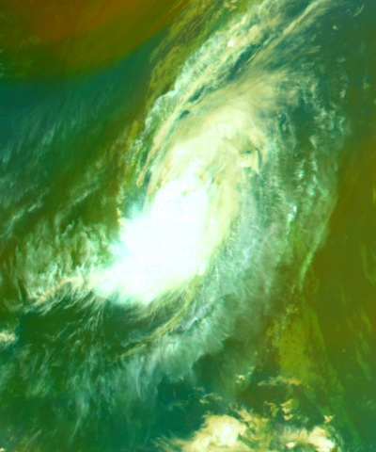
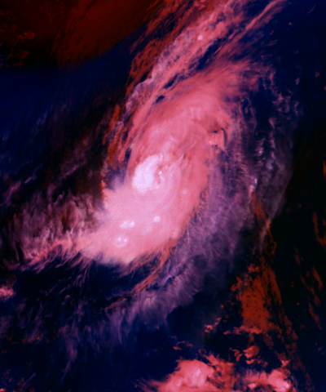
Airmass RGB is over-enhanced for cold clouds
= Overshooting Tops
Airmass RGB “Hurricane” RGB
14 September 2010, 19:45 UTC
(Hurricane Julia)
Slide by Jochen Kerkmann

Slide 9
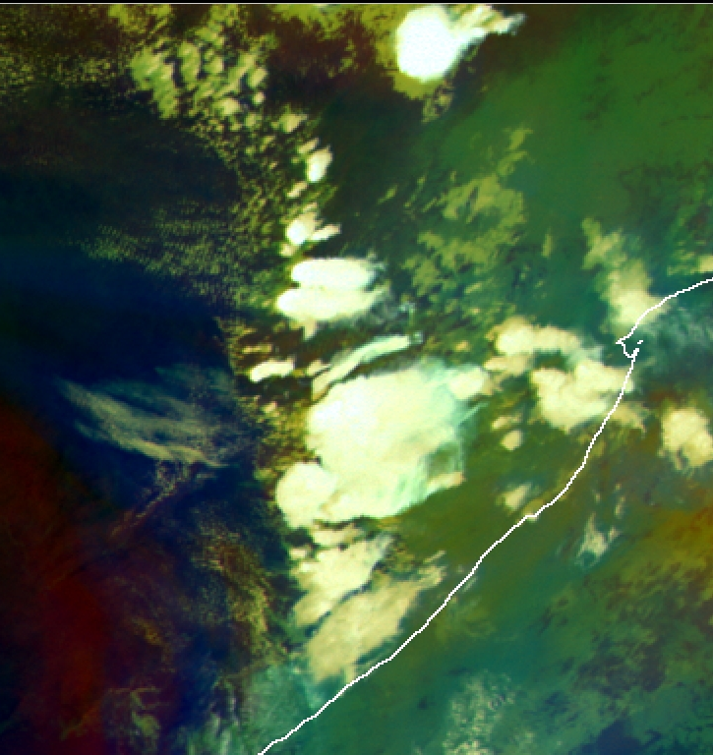
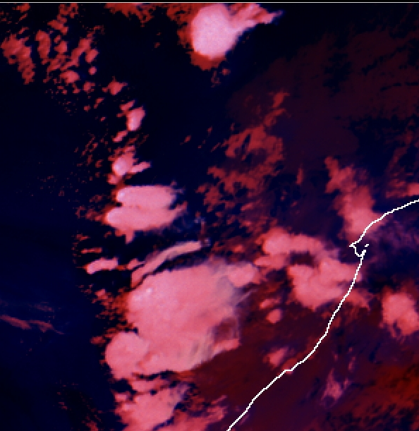
27 Oct 2004 1300 UTC
Example by Jochen Kerkmann

Slide 10
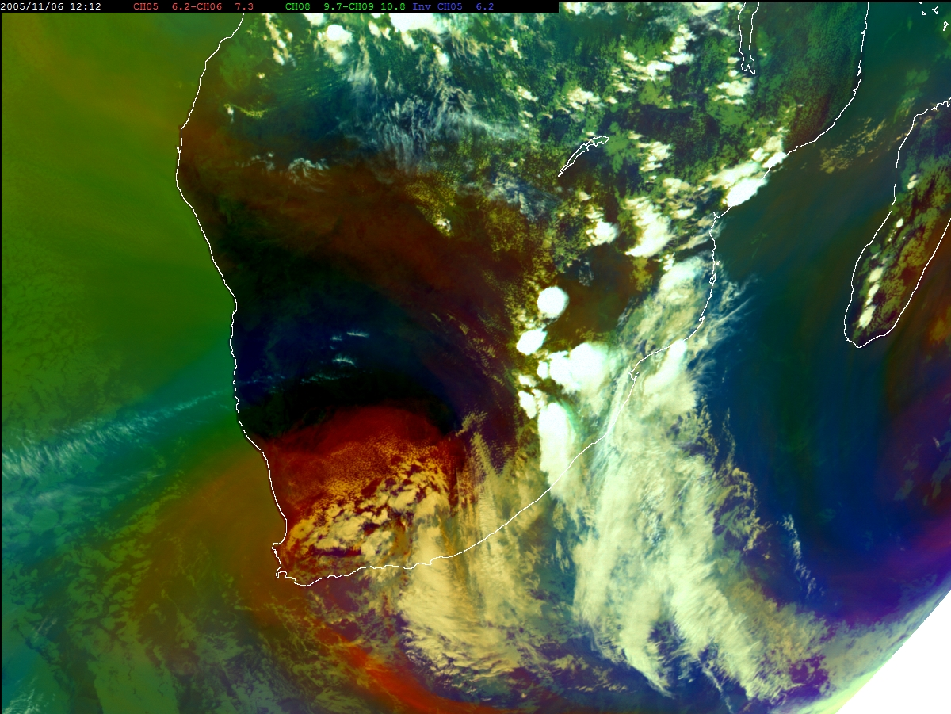
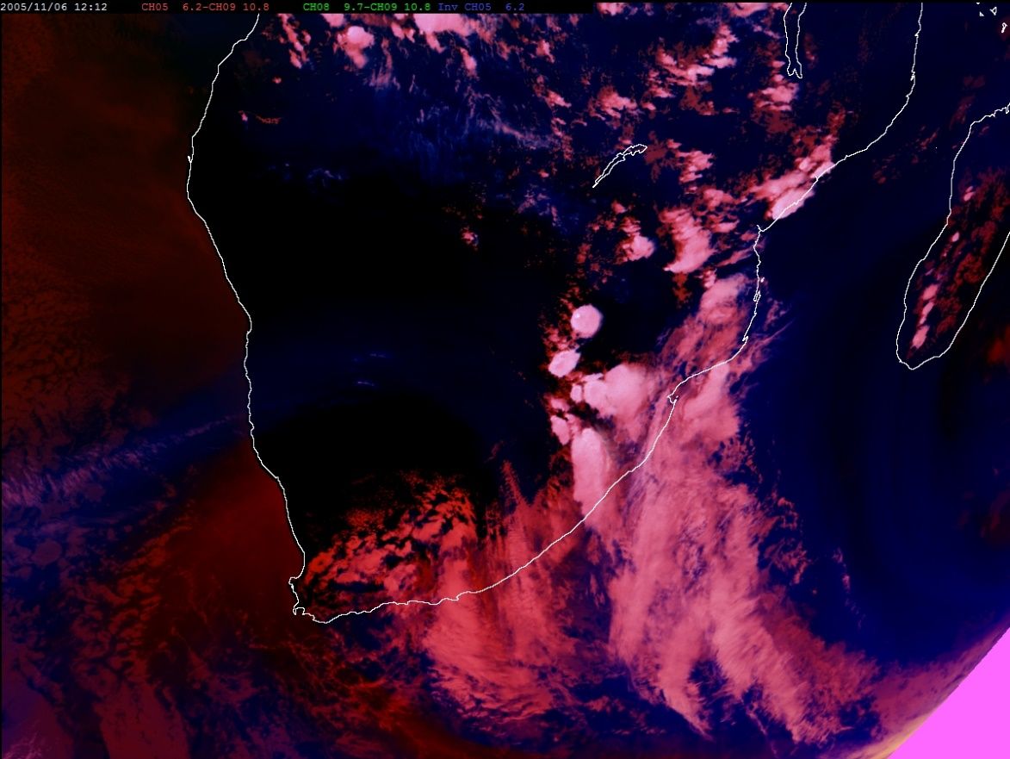
6 Nov 2005 1200 UTC
Example by Jochen Kerkmann

Slide 11
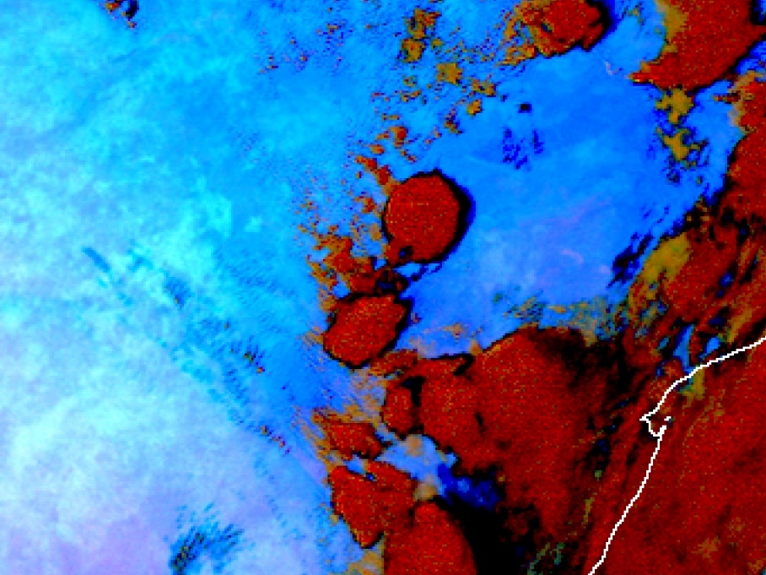
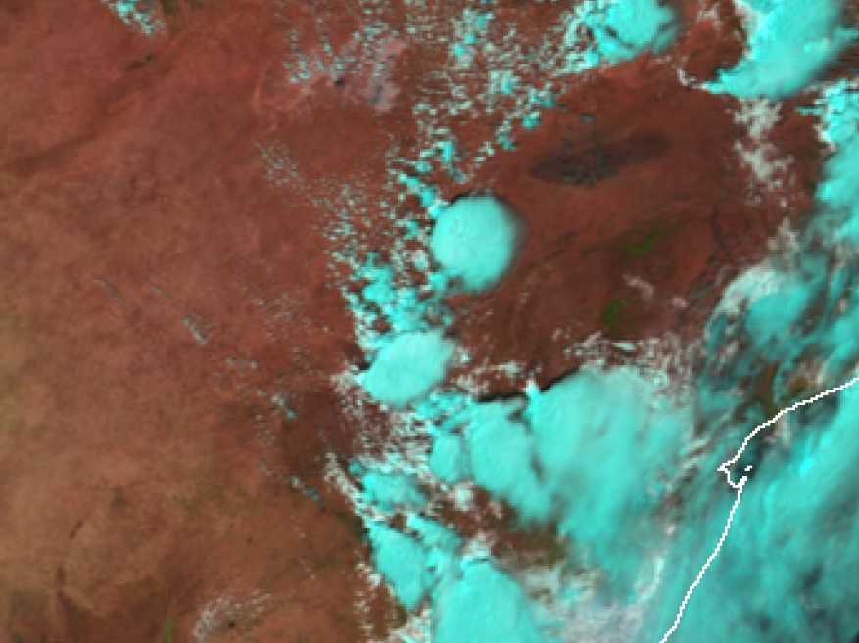
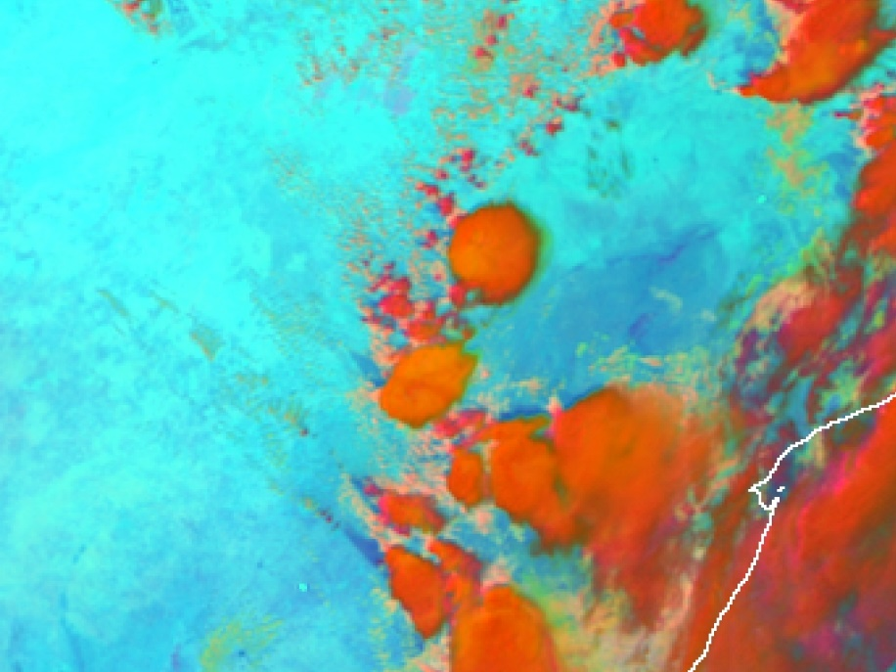
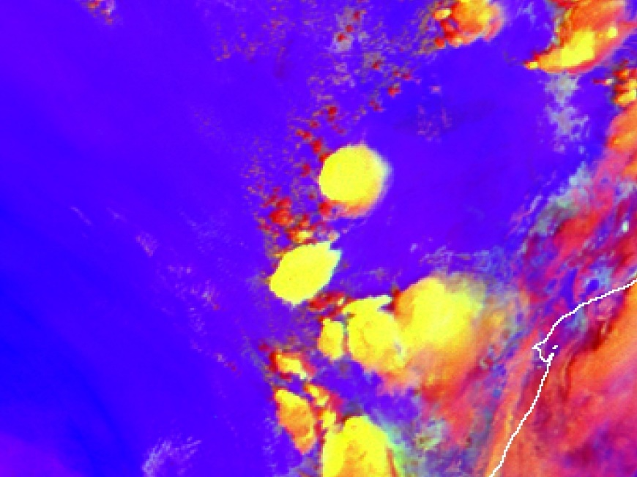
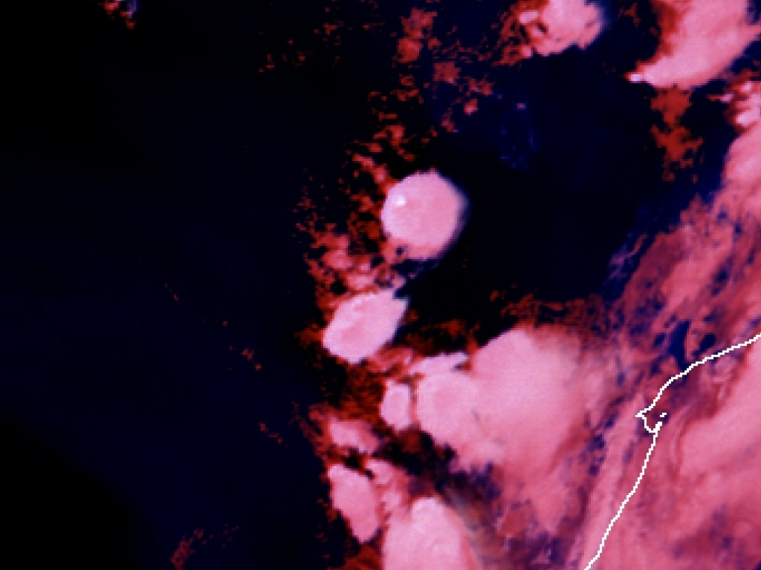
Dust
Day Natural
Day Microphysical
Convection
6 Nov 2005

Slide 12
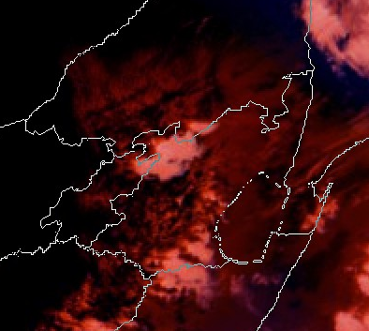
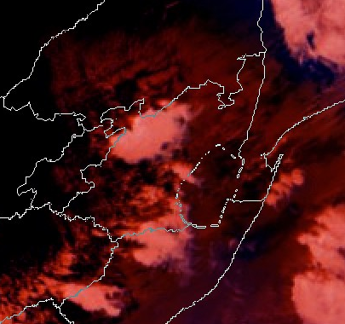
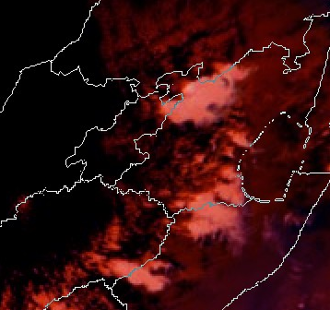
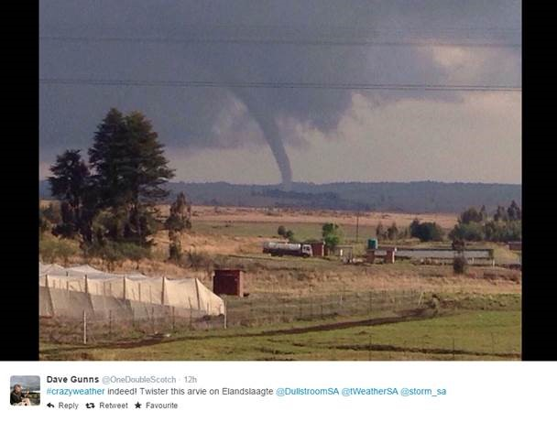
16 Oct 2014 - Tornado in Limpopo
1000 UTC
0945 UTC
0930 UTC

Slide 13
Summary
Overshooting tops are the most intense part of thunderstorms
This is where the strongest updrafts are and thus also possible severe weather
To identify this part of the thunderstorm can help with severe weather warnings.
The OT RGB is successful in improving the observation of severe convective systems, including the tornado event on 16 Oct 2014

